Slide 1
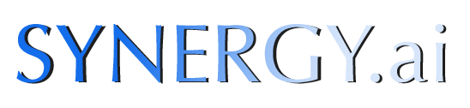

Devon Hackathon 2017

Slide 2

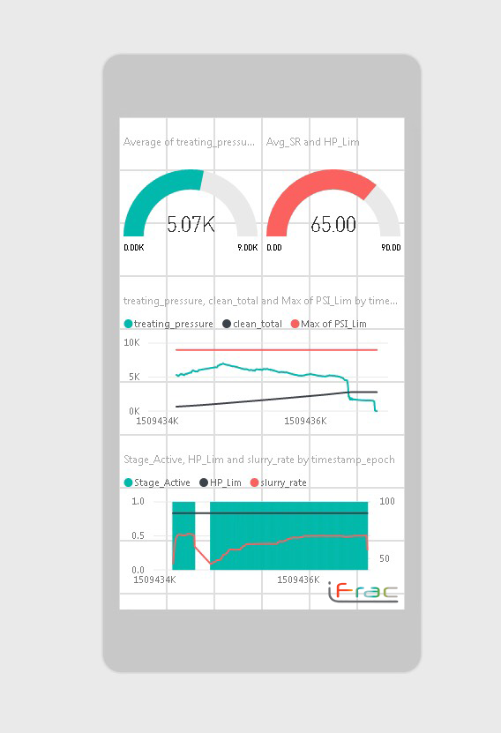
Structure
Simulating live data streaming
PI web API to Azure SQL server
Power BI Visualization-mobile enabled
Identifies stage start/stop
Reduce FR Conc 15%
Target 92.5 bpm

Slide 3
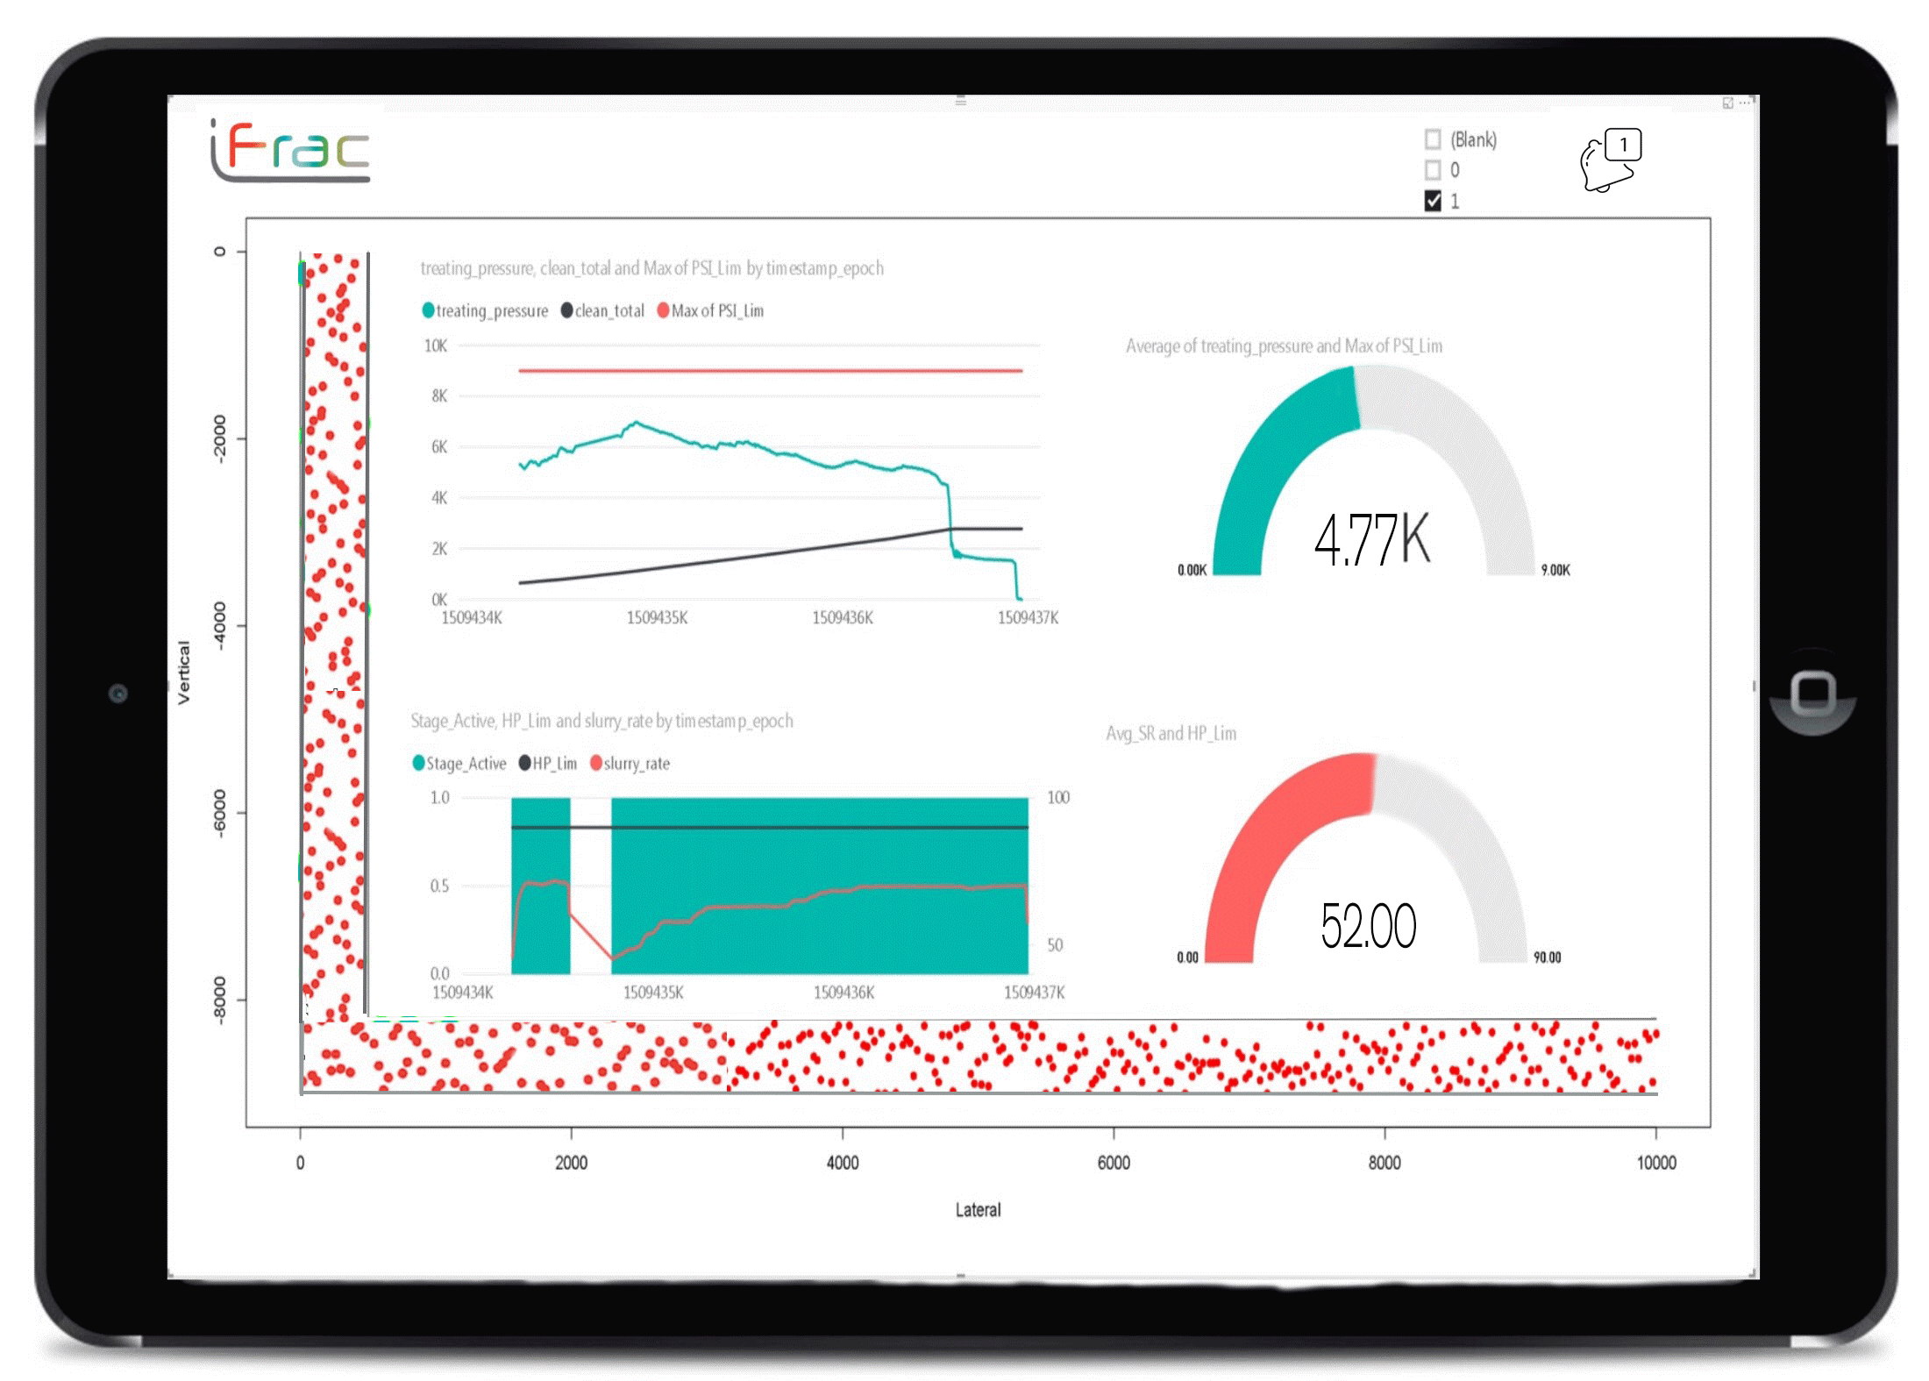
Reduce FR Conc 15%
Target 92.5 bpm

Slide 4
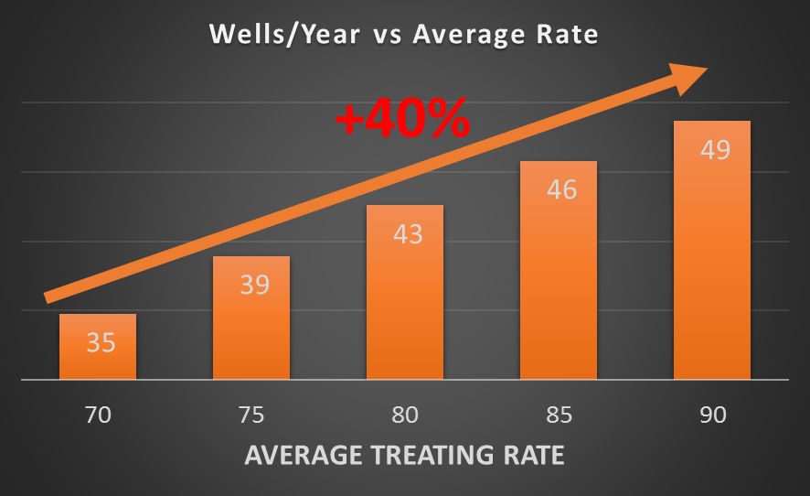
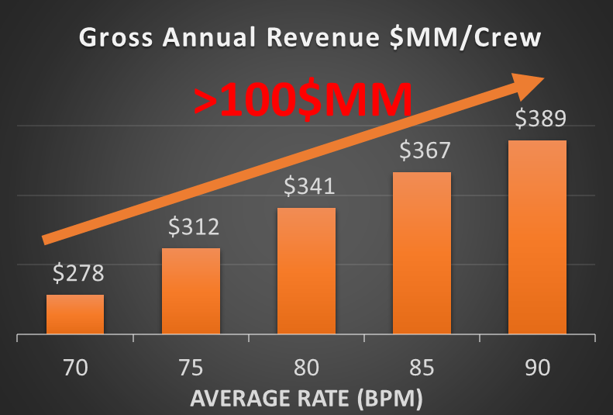
Impact
Optimize average rate
Accelerate production and value
Complete 40% more wells/yr
+$100MM/yr/crew gross revenue

Slide 5
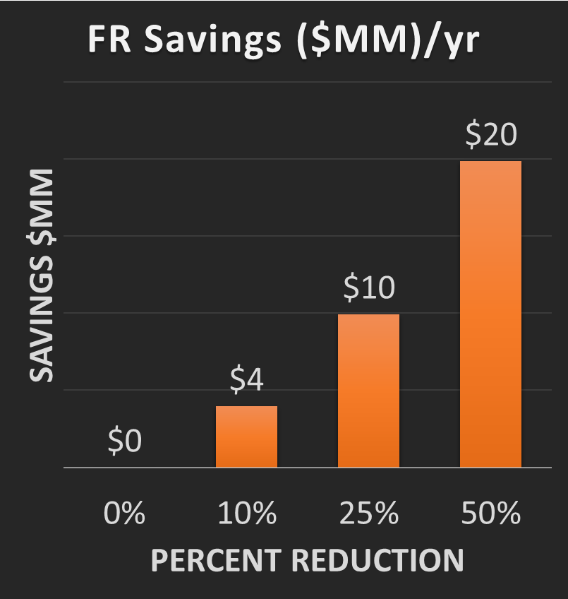
Impact
Machine learning optimizes FR
Based on average treating pressure
Tight variance from contract pressure
Avoid overspending on chemical
Savings based on 6 frac crews

Slide 6
Thank You.
T. Nguyen, J. Melton, D. Griffin, K. Cox, K. Haustveit

Slide 7
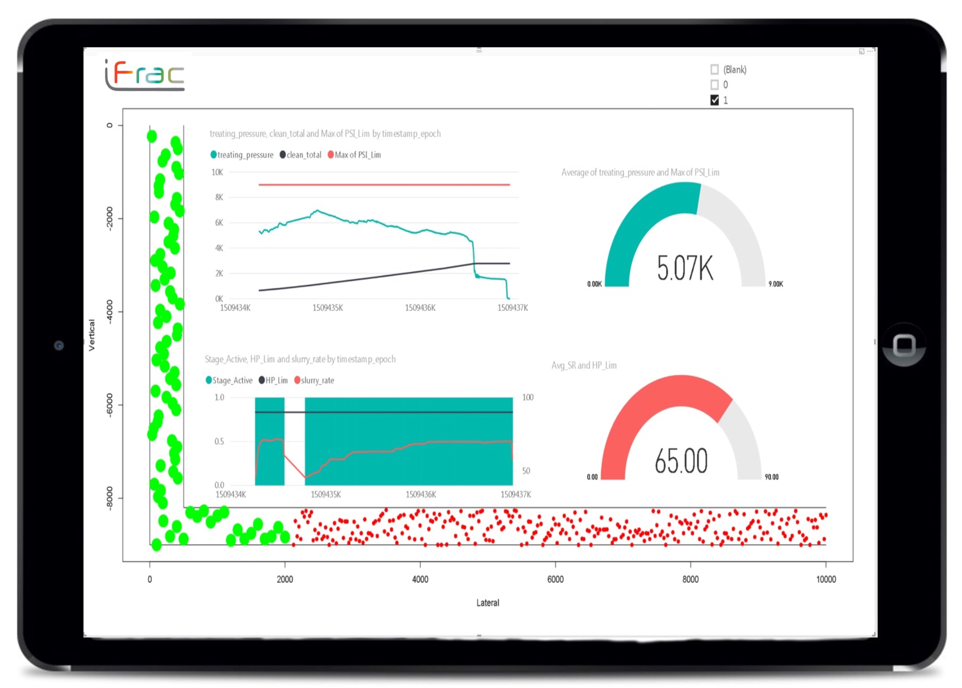
Reduce FR Conc 15%
Target 92.5 bpm

Slide 8
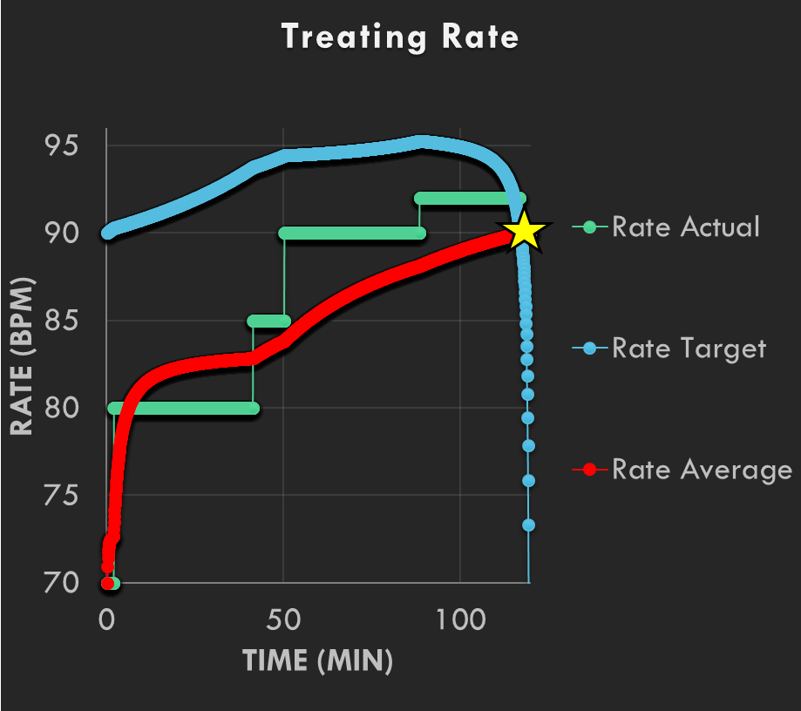
Structure
Optimize average rate
Accelerate production and value
Complete 40% more wells/yr
>$100MM/yr/crew gross revenue

